Slide 1
Website Purpose & Audience
Website Development

Slide 2

Introduction
Websites are everywhere in our daily lives, serving a variety of purposes depending on their design and audience.
From online shopping to entertainment, websites play a key role in how we interact with the digital world.
Understanding the purpose of different types of websites, and the audiences using them, can help you see how to meet the needs of their users.
In this lesson, we’ll learn about:
The purposes of websites
Understanding target audiences

Slide 3
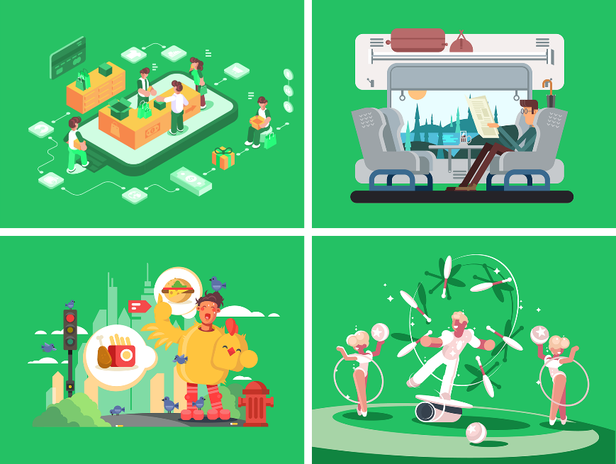
The Purposes of Websites
Websites serve a multitude of functions in today's digital world.
Understanding the primary purpose of a website is the first step in its successful development, as it dictates the content, design, and functionality.
The common purposes of websites are:
eCommerce
To provide information
To promote products or services
To provide entertainment
Let’s look at each of these in more detail.

Slide 4

eCommerce Websites
eCommerce websites facilitate online buying and selling.
Their primary goal is to convert visitors into customers via a seamless shopping experience.
Key features include product catalogues, shopping carts, secure payment gateways, and order management.
Examples include Amazon and Supermarket websites, focusing on high-quality images, clear calls-to-action, and robust security for transactions.
Considerations include user-friendly navigation and mobile responsiveness.

Slide 5

Informational Websites
Many websites aim to provide information to a broad audience, covering topics such as news, education, or government services.
The focus is on clarity, accuracy, and easy access to content.
Examples include BBC News and government sites, which feature well-organised content, search functionality, and clear navigation.
Regular updates, reliable sources, and accessibility features are crucial for these sites.

Slide 6

Promotional Websites
Promotional websites build brand awareness and generate leads, encouraging engagement with a business's offerings.
They may not sell directly, but they provide compelling reasons for further interaction.
Examples include car manufacturers and design portfolios, using engaging visuals, compelling copy, testimonials, and contact forms.
Strong calls-to-action and SEO are vital for attracting target audiences and highlighting unique selling propositions.

Slide 7

Entertainment Websites
Entertainment websites engage users through various media and interactive experiences.
Success is measured by user engagement and repeat visits.
Examples include streaming services, like Netflix, and online gaming platforms.
These sites feature rich media, interactive elements, and social sharing.
Fast loading times, robust servers, and intuitive user interfaces are essential for a seamless and engaging user experience.

Slide 8

Understanding Your Target Audience
Understanding your target audience is crucial for creating an effective website.
A website designed without clear user insight is unlikely to succeed.
Knowing your users allows you to tailor content, design, and functionality to meet their specific needs and preferences.
This ensures the website achieves its intended goals.
Two good tools for understanding your target audience are:
Demographics
User personas
Let’s look at each of these in more detail.

Slide 9

What are Demographics?
Demographics are simply measurable facts about a group of people, providing a broad overview of your potential users.
These characteristics provide an initial understanding of who might visit your website, enabling you to make informed decisions about design and content.
Key demographic categories include age, gender, location, income, education, occupation, and ethnicity.
For instance, a website designed for teenagers might use vibrant colours and interactive elements.
In contrast, a site for seniors might prioritise larger text and more straightforward navigation for accessibility.
Understanding these basic characteristics helps in shaping the initial direction of your website development.

Slide 10
How Do Demographics Influence Website Design?
Knowing your audience's demographics has a significant impact on various design and development choices for your website.
These factors affect the tone and language used, determining if it should be formal or informal, simple or technical.
They also dictate visual design elements such as colour palettes, imagery, and typography.
For example, a website for teenagers might use vibrant colours, while one for older people might use larger text for easier reading.
Furthermore, demographic insights help in designing user interface elements, including the placement of buttons and navigation styles.
Understanding demographics ensures the website is effectively marketed and promoted.

Slide 11
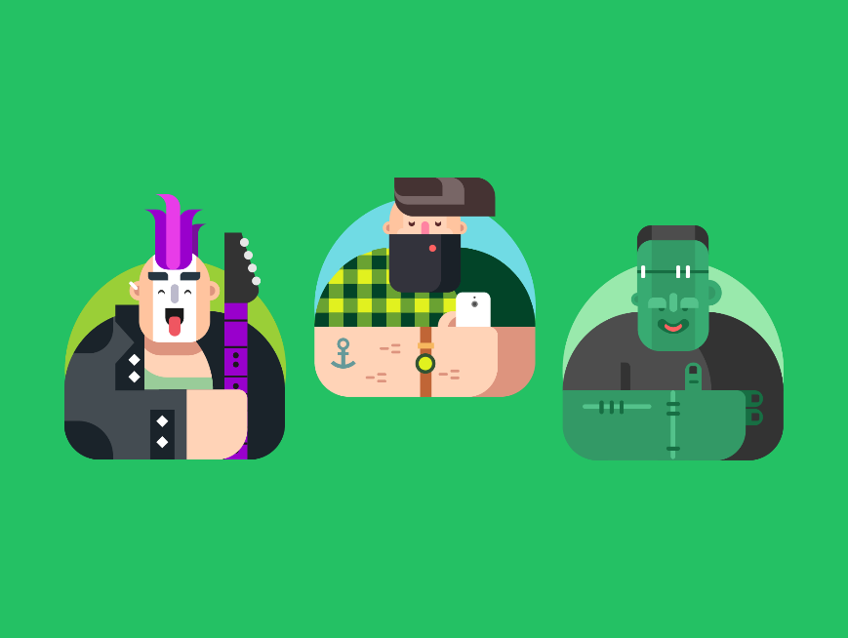
What are User Personas?
While demographics provide a broad picture, user personas offer a much deeper, more detailed understanding of your target audience.
A user persona is a fictional yet typical representation of your ideal user, created based on research & data about your target audience.
They move beyond simple facts to consider elements like behaviours, motivations, goals, and pain points.
Elements typically include a name, photo, demographic details, bio, goals, motivations, frustrations, behaviours, & technical proficiency.
Personas provide a human touch to data, enabling more empathetic and user-centred design decisions.
This detailed insight helps ensure the website achieves its intended goals by tailoring content, design, and functionality to specific user needs.

Slide 12
How Do User Personas Influence Website Design?
User personas help bridge the gap between data and design, allowing developers to empathise with users.
This deeper understanding leads to better user-centred design decisions, ensuring features help people achieve their goals.
Website content is chosen to answer the persona’s questions and solve their problems.
User Experience design is optimised to match the persona's behaviours and expectations.
Personas also serve as a crucial reference during usability testing.
Ultimately, referring to personas provides clear direction for design decisions.

Slide 13

Lesson Summary
Websites serve various key purposes, including eCommerce, providing information, promoting products or services, and offering entertainment, each dictating specific design and functionality.
Understanding the target audience is crucial for effective website creation, as it enables the tailoring of content, design, and functionality to meet user needs.
Demographics provide broad, measurable facts about potential users (like age and location), guiding initial design and content decisions.
User personas offer a deeper, detailed understanding of ideal users, encompassing their behaviours, motivations, goals, and pain points, enabling user-centred design.

Slide 14
Copyright © 2025 KnowItAllNinja.com
This presentation and its associated worksheets are protected by copyright and are licenced for resale by KnowItAllNinja.com. No part of these publications may be reproduced, distributed, or transmitted in any form or by any means, including photocopying, recording, or other electronic or mechanical methods, without the prior written permission of KnowItAllNinja.com, except as per the terms of use.
Terms of Use
By purchasing and downloading these resources you are entering a licence agreement that allows for you to share these resources with members of a single educational institution. They must not be shared with or used by any third-party outside of the institution in any form.

