Slide 1
Online Services 1
The Online World

Slide 2

Introduction
Online services are an important aspect of our modern lives. If you’ve ever used the Internet to message someone, look up the news, buy a product, or watch a TV show, then you’ve used online services.
We access all of these things all the time, not just when sitting at our PC or laptop but wherever we are, on our phones, tablets, or even smartwatches.
In this lesson, we’ll learn about:
Communication Services
Real-Time Information Services
Commerce Services
Government Services

Slide 3

Communication Services
When we talk about communication services, we are talking about any online method of sharing and transferring data between different people.
Common types of communication services include the following:
Email
Instant messaging
News groups
Social networking
Web conferencing
Blogs
Let’s take a look at each one of these in more detail.

Slide 4

Types of Communication Services
Email
Short for electronic mail, this lets us send written messages instantly to the other side of the world using the internet. This is much quicker than using traditional mail.
Instant Messaging
This allows us to have private written conversations with an individual or group of people. It’s a great way of organizing a meeting with a group of friends and is cheaper than a phone call.

Slide 5
Types of Communication Services
Newsgroups
These are similar to modern-day Internet forums and are used to discuss topics and share ideas.
Unlike instant messaging, newsgroups are public. Anyone accessing the newsgroup can read the messages that have been posted.
Social Networking
Websites like Twitter or Facebook allow us to share our thoughts, opinions, and pictures quickly with all of our friends and family.
This helps us keep in touch with our wider friendship groups, whom we might otherwise lose contact with.

Slide 6
Types of Communication Services
Web Conferencing
Software like Skype allows us to talk with people via voice or video call, so you can see them as you’re talking.
This is a fantastic way of keeping in touch with friends and family who live abroad and much cheaper than an international phone call, too.
Blogs
Short for Web Logs, these are web pages that are regularly updated and typically used as a public online journal.
Vlogs, or Video Logs, are similar but are done through video, and they usually use sites such as YouTube to share and receive comments.

Slide 7
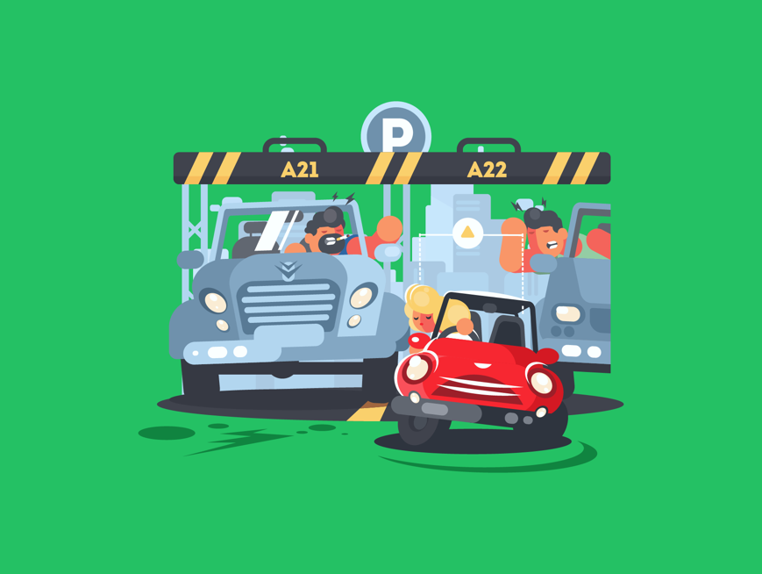
Real-Time Information Services
Real-time information services are used to get the latest, up-to-date information on a particular topic.
Common types of real-time information services include:
Train timetables
News services
Traffic reports
Flight status updates
Weather reports
Let’s take a look at each one of these in more detail.

Slide 8

Types of Real-Time Information Services
Train Timetables
These are used to look up the departure and arrival times of trains so we can plan our journeys, ensure we are on time, and check for train delays.
News Services
Keep us informed about the latest events. The BBC news website, for example, has the latest news stories on a variety of topics.
Traffic Reports
Information on traffic, such as road accidents or congestion, is now often integrated into route-planning websites like Google Maps, which highlights heavy congestion in red when you plan a route.

Slide 9
Types of Real-Time Information Services
Flight Status Updates
Identify flight arrival times, delays, etc. If you are picking someone up from the airport, you want to know if their flight has been delayed so you don’t arrive too early.
Weather Reports
Weather updates and forecasts for the week ahead so that we can plan outdoor events.

Slide 10

Commerce Services
Commerce services allow us to manage our money and buy and sell items over the Internet.
These services are becoming more common and now form an integral part of how we do business.
Common types of commerce services include:
Online banking
Auction sites
Retail sales
Electronic publishing
Let’s take a look at each one of these in more detail.

Slide 11

Types of Commerce Services
Online Banking
Check how much money you have, pay people, or transfer money into different accounts, such as to a friend or to your savings.
This is quicker and easier than banking in person and is available 24/7.
Auction Sites
Websites like eBay allow us to sell things we own to other people directly. People bid on your item, such as a jumper, and whoever bids the highest gets it.

Slide 12
Types of Commerce Services
Retail Sales
These are websites that allow us to do all our regular shopping online. We can buy our groceries, clothes, electrical equipment, and anything else online from the same stores you might visit.
It’s also common for many shops to only sell online, like Amazon.
Electronic Publishing
Produce digital publications such as books and magazines so you can buy them online and instantly download them to your computer, tablet, smartphone, or specialist e-reader like the Amazon Kindle.

Slide 13

Government Services
Government services are where the local and national governments allow you to perform common tasks online rather than at council offices, the post office, or polling stations.
Common types of government services include:
Online tax returns
E-voting
Online application for grants and benefits
Let’s take a look at each one of these in more detail.

Slide 14
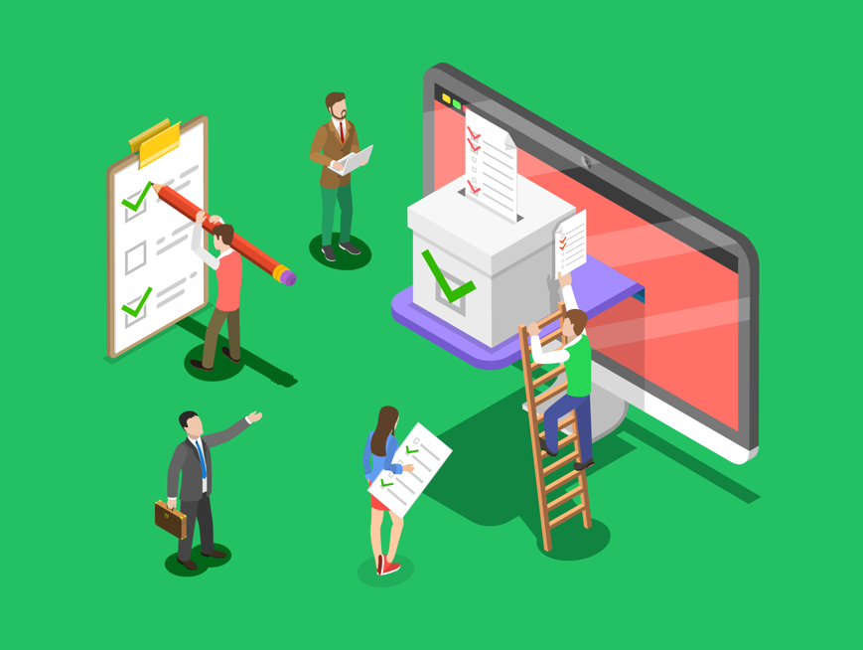
Types of Government Services
Online Tax Returns
You can complete tax returns online to ensure you’ve paid the right amount of tax to the government. This is quicker, easier, and can check for mistakes automatically, which makes it beneficial to traditional paper-based tax returns.
E-Voting
We can cast our votes in elections without having to visit polling stations. This allows people who live in remote areas or have mobility issues to cast their votes without difficulty.
Online Application for Grants and Benefits
Housing benefits, car tax, or TV licenses can be applied for online instead of at council offices, post offices, etc. This saves a lot of time, both in travelling and in avoiding long queues.

Slide 15

Lesson Summary
We use online services for communication such as with email, instant messaging, newsgroups, social networking, online conferencing & blogs.
We also use online services for real-time information such as train timetables, news services, traffic reports, flight status updates & weather forecasts.
We use online services for commerce such as internet banking, online auction websites, retail sales & publishing.
Finally, we use online services for government such as online tax returns, e-voting & applications for services & grants.

Slide 16
Copyright © 2024 KnowItAllNinja.com
This presentation and its associated worksheets are protected by copyright and are licenced for resale by KnowItAllNinja.com. No part of these publications may be reproduced, distributed, or transmitted in any form or by any means, including photocopying, recording, or other electronic or mechanical methods, without the prior written permission of KnowItAllNinja.com, except as per the terms of use.
Terms of Use
By purchasing and downloading these resources you are entering a licence agreement that allows for you to share these resources with members of a single educational institution. They must not be shared with or used by any third-party outside of the institution in any form.

